Slide 1

Project – Predict the City Taxi Trip Duration

Slide 2
Challenge
Business Goal: To improve the efficiency of electronic taxi dispatching systems it is important to be able to predict how long a driver will have his taxi occupied. If a dispatcher knew approximately when a taxi driver would be ending their current ride, they would be better able to identify which driver to assign to each pickup request.
ML Goal: To build a model that predicts the total ride duration of taxi trips in New York City
Data: The taxi trip records include fields capturing pick-up and drop-off dates/times, pick-up and drop-off locations, trip distances, itemized fares, rate types, payment types, and driver-reported passenger counts. The data used in the attached datasets were collected and provided to the NYC Taxi and Limousine Commission (TLC) by technology providers authorized under the Taxicab & Livery Passenger Enhancement Programs (TPEP/LPEP).
Data Source: https://www1.nyc.gov/site/tlc/about/tlc-trip-record-data.page

Slide 3
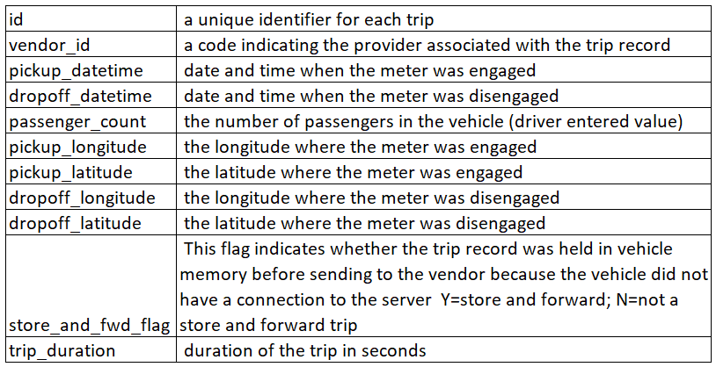
About Data

Slide 4
Project Tasks
Data Gathering
Data pre-processing
Data Cleaning
Missing value analysis
Exploratory Data Analysis
Feature Creation
Train Model
Test Model

Slide 5
Project Submission
Create a presentation documenting all the project steps
Presentation Template can be found in GitHub Repository
You are encouraged to use your own templates but ensure all the steps are clearly explained
Attach the presentation using the Google form in next section

Slide 6
Thank You!
Keep learning Keep exploring
www.elitetechnogroups.com

